Slide 1


SYNTHETIC DATA GENERATION USING GANS
Presented By : Soumya Savarn (220150031)
DA312 | Advanced ML Laboratory

Slide 2
OVERVIEW
Abstract
Theoretical
Implementation
Introduction
Objectives
Result
Problem
Hypothesis
Conclusion
Literary Review
Methodology
Recommendation
DA312 | Advanced ML Laboratory
1

Slide 3
INTRODUCTION
In this project, I built a streamlit app to generate synthetic
data using GANs. My app can work with both tabular (CSV)
and image (JPG/PNG) data. I used CTGAN and vanilla GANs
for tables, and a trained Pix2Pix GAN for comic face images. I
also checked how adding synthetic data helps machine learning
models, using the Iris dataset as an example.
DA312 | Advanced ML Laboratory
2

Slide 4
PROBLEMS IN ML
First Problem
Second Problem
We do not have enough real data for machine
learning.
Privacy of data on which we are training.
3

Slide 5
THEORETICAL FRAMEWORK
Streamlit app
Used CTGAN and Vanilla GAN for tabular datasets.
Trained a Pix2Pix GAN for image generation.
Performance check using synthetic data
Got a performance boost in ML algorithms on Iris dataset.
DA312 | Advanced ML Laboratory
4

Slide 6
DATASETS
Comic Face: https://www.kaggle.com/datasets/defileroff/comic-faces-paired-synthetic-v2
Iris dataset
Student Depression: https://www.kaggle.com/datasets/hopesb/student-depression-dataset
DA312 | Advanced ML Laboratory
4

Slide 7
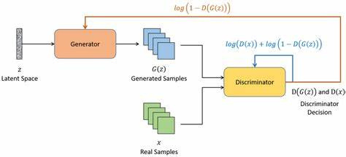
VANILLA GAN
DA312 | Advanced ML Laboratory
5

Slide 8
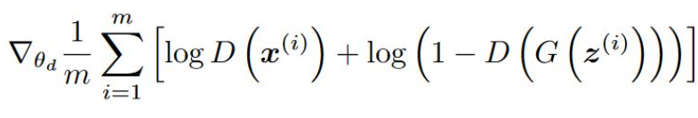
VANILLA GAN
Loss Function
DA312 | Advanced ML Laboratory
5

Slide 9
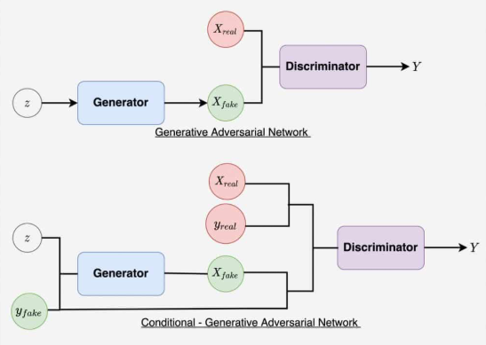
CTGAN
4
DA312 | Advanced ML Laboratory

Slide 10
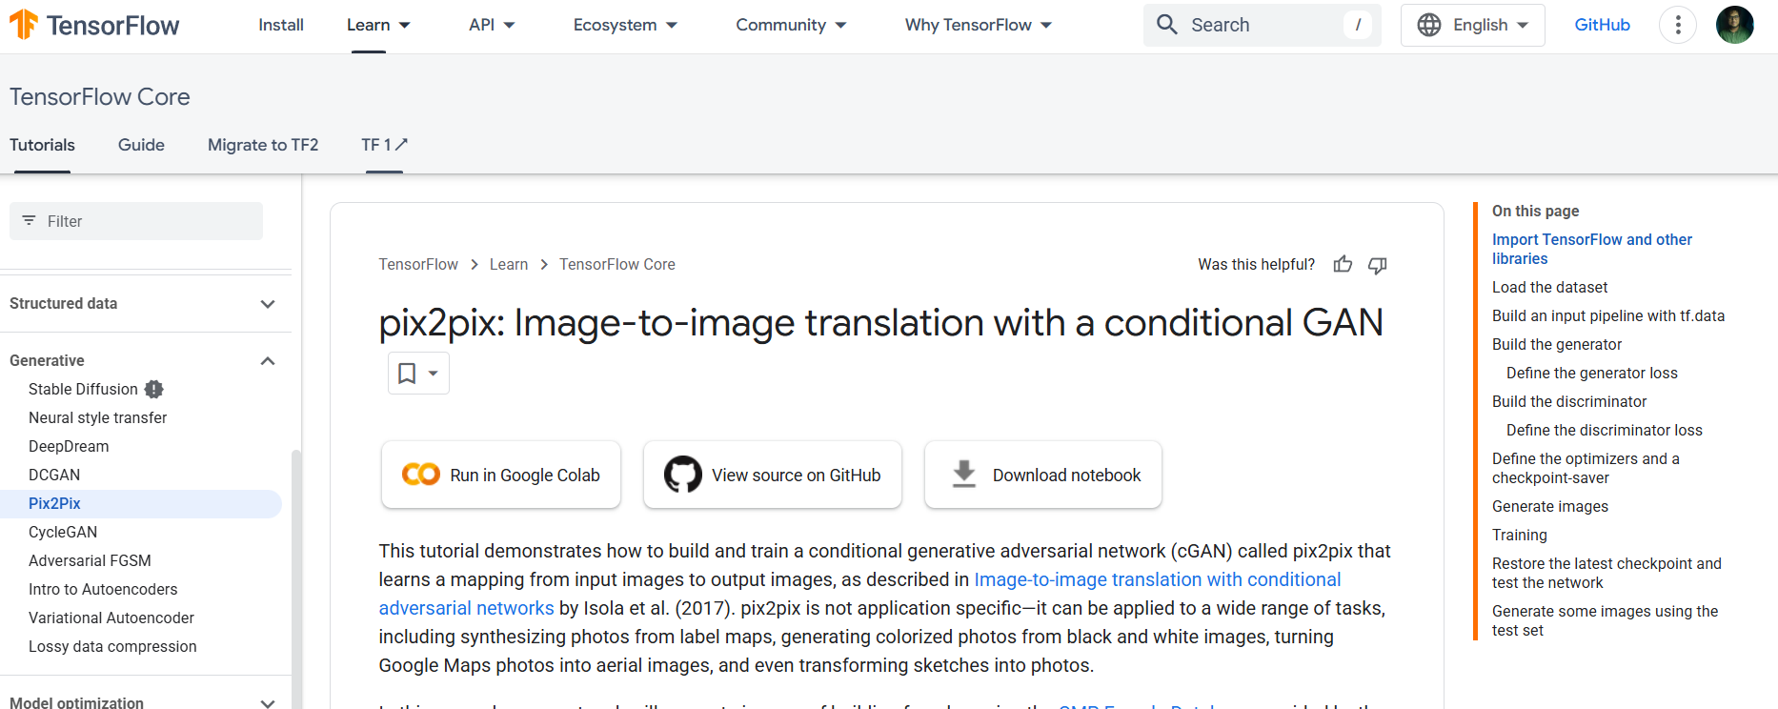
PIX2PIX GAN
https://www.tensorflow.org/tutorials/generative/pix2pix
DA312 | Advanced ML Laboratory
4

Slide 11
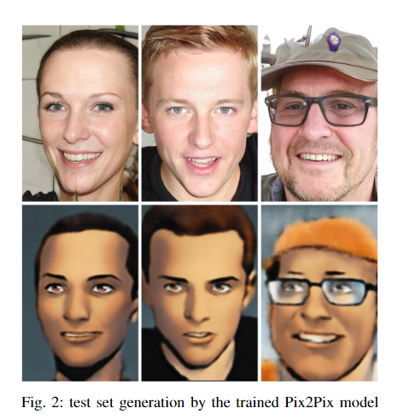
PIX2PIX GAN
4
https://www.kaggle.com/code/soumyasavarn/imagegeneration-model-pix2pix-training
DA312 | Advanced ML Laboratory

Slide 12
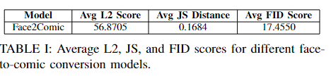
PIX2PIX GAN
https://www.kaggle.com/code/soumyasavarn/model-testing-pix2pix?scriptVersionId=235064753
4
DA312 | Advanced ML Laboratory

Slide 13
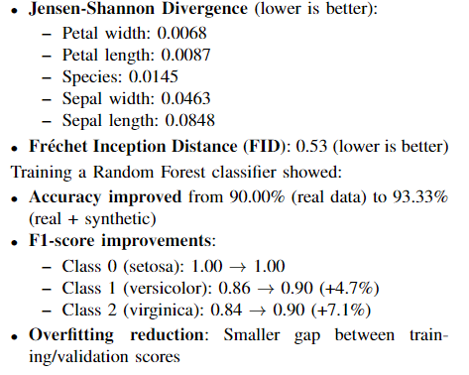
PERFORMANCE BOOST ON IRIS DATASET
DA312 | Advanced ML Laboratory
4

Slide 14
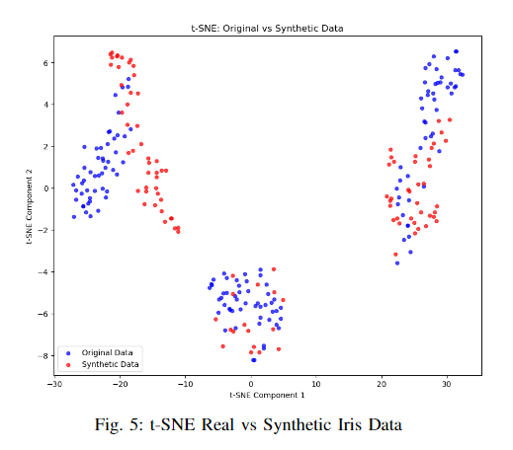
PERFORMANCE BOOST ON IRIS DATASET
DA312 | Advanced ML Laboratory
4

Slide 15
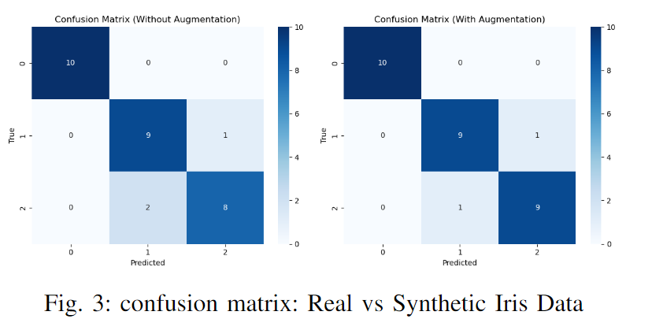
PERFORMANCE BOOST ON IRIS DATASET
DA312 | Advanced ML Laboratory
4

Slide 16
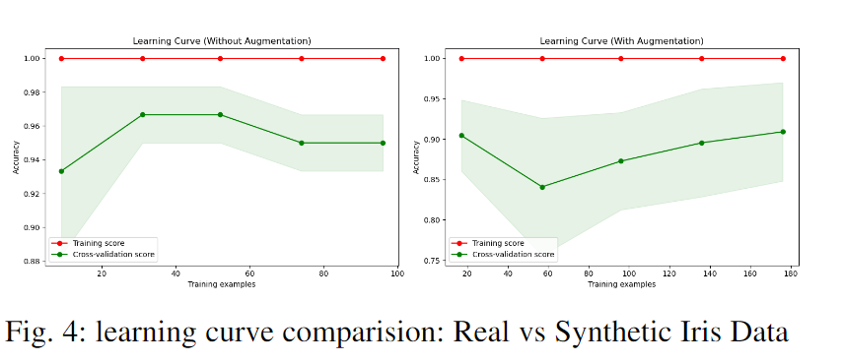
PERFORMANCE BOOST ON IRIS DATASET
DA312 | Advanced ML Laboratory
4

Slide 17

EVALUATION METRICS DETAILS
JS Divergence:
FID (Frechet Inception Distance):
The FID compares the distribution of generated images with the distribution of a set of real images (a "ground truth" set). Rather than comparing individual images, mean and covariance statistics of many images generated by the model are compared with the same statistics generated from images in the ground truth or reference set.
Source: https://en.wikipedia.org/wiki/Fr%C3%A9chet_inception_distance
DA312 | Advanced ML Laboratory
4

Slide 18
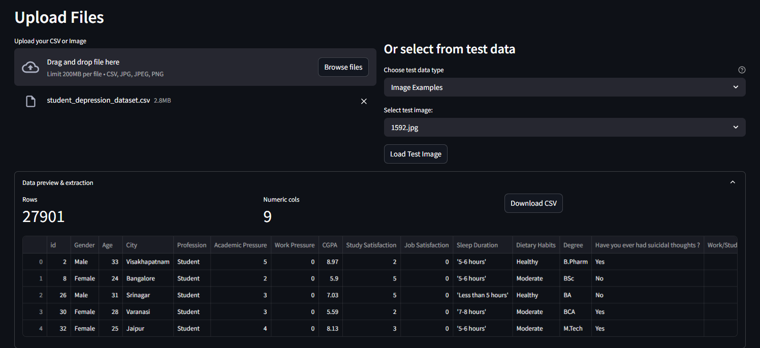
APP DEMO
DA312 | Advanced ML Laboratory
7

Slide 19
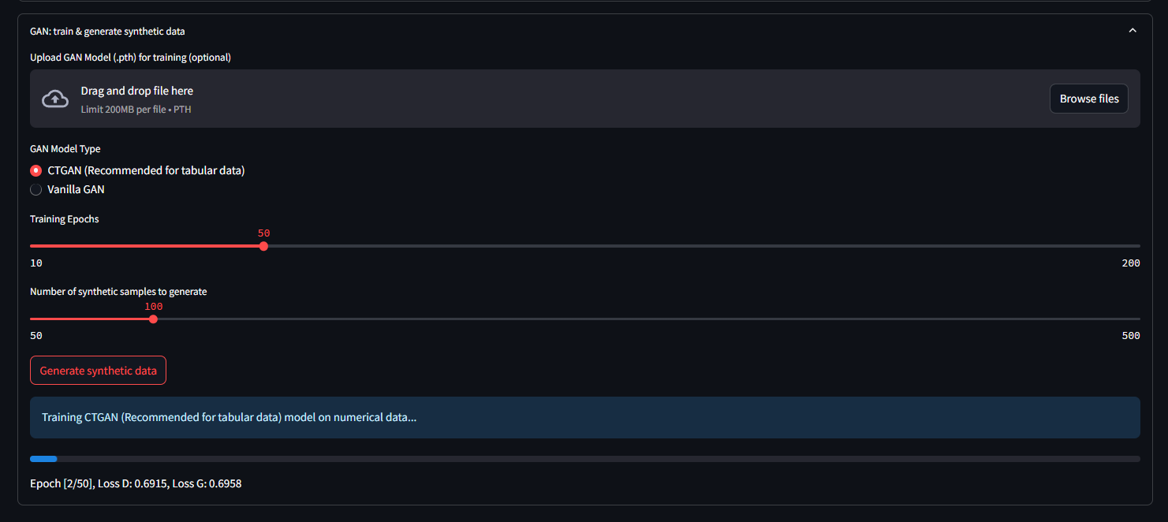
APP DEMO
DA312 | Advanced ML Laboratory
7

Slide 20
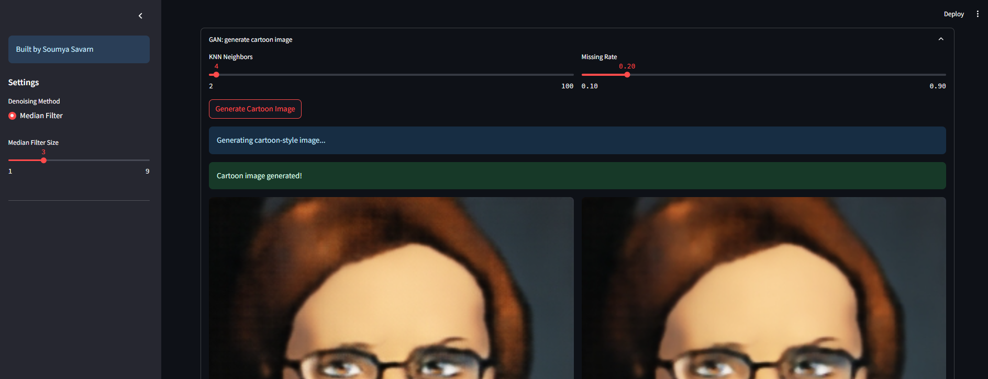
APP DEMO
DA312 | Advanced ML Laboratory
7

Slide 21
APP DEMO
DA312 | Advanced ML Laboratory
7

Slide 22

DA312 | Advanced ML Laboratory
THANK YOU
Presented By : Soumya Savarn

